Slide 1
Yelp Data Analysis
Chouthai, Rohan
Rajnalwar, Chandrakiran

Slide 2

DATASET
There is a total of 7 csv files and we will be exploring 4 of them, They are as follows-
Yelp Business- (175k rows, 13 columns)
Yelp Check-in- (3.91m rows, 4 columns)
Yelp Reviews-(9 columns)
Yelp User- (22 columns)
Yelp Tip- (1 M rows, 5 columns)

Slide 3

Yelp Business Analysis

Slide 4
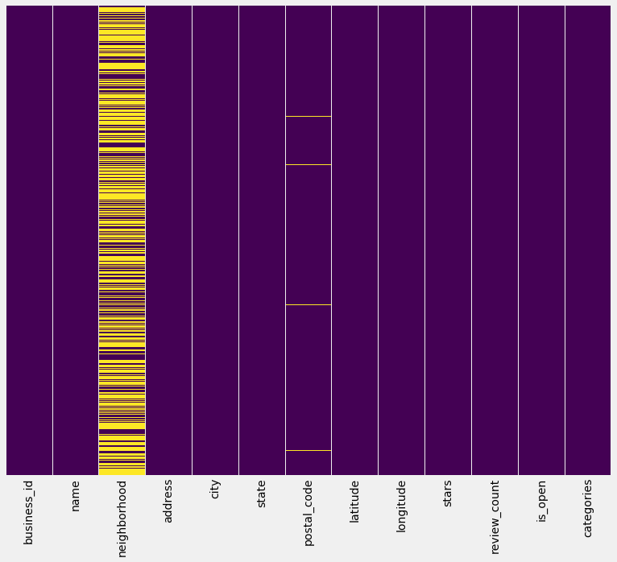
Visualizing the null values with a Heat Map
It is important to check out the null values in the data before we proceed with the analysis.
By looking at the heatmap we can see that there are lot of null values in neighborhood column.
Libraries: Seaborn

Slide 5
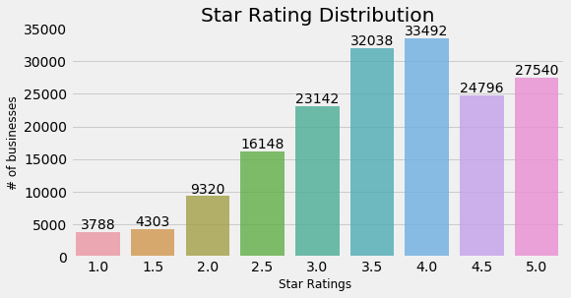
Star Rating Distribution for the Yelp Businesses
We use a bar plot to visualize the counts of all the ratings.
We can see that maximum businesses are rated 3 or greater than 3
In fact, there are maximum businesses with a 4 rating
Libraries: Seaborn

Slide 6
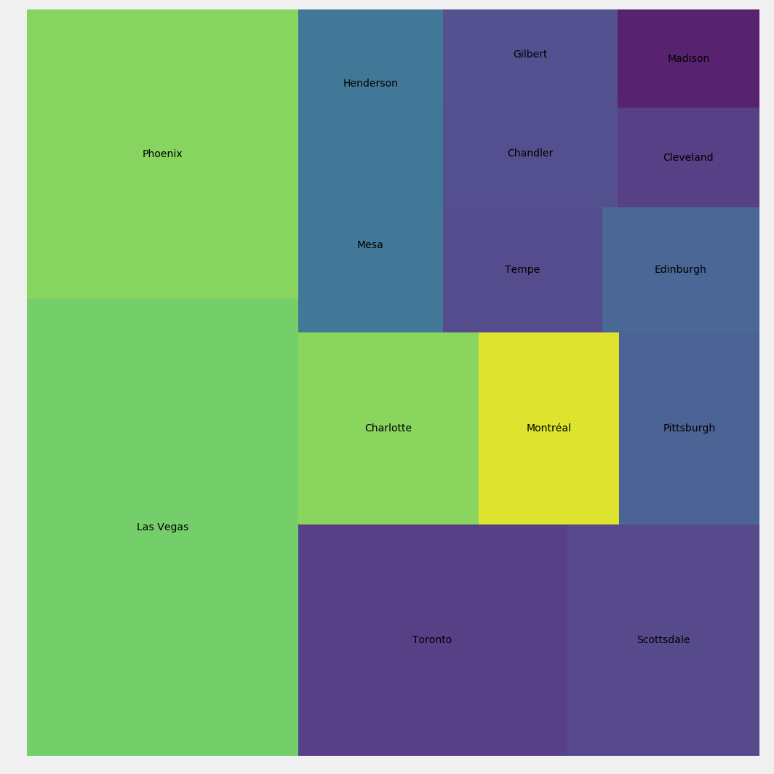
Cities with best Businesses
Assuming businesses above star rating 4 as best businesses, we use heat map to plot cities with most number of best businesses
As we can see maximum number of best businesses are located in Las Vegas and Phoenix cities

Slide 7
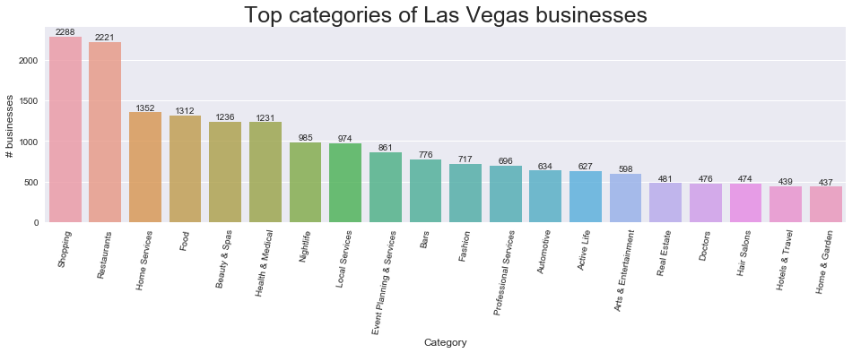
Top Categories in Las Vegas business
Shopping is the most popular category of business in Las Vegas followed by Restaurants.
Home services, food and Beauty are the next biggest categories.
These findings clearly show what a big tourist place Las Vegas is.

Slide 8

Yelp Users

Slide 9
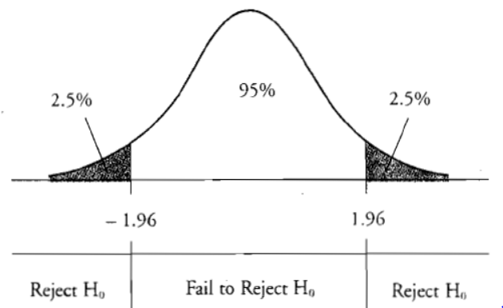
Classical Data Science: Hypothesis Testing
We examine yelp users’ average stars.
Null hypothesis- Old yelp users have higher average stars rating.
Two sample T test results:
P value= 5.22 >0.05
Two sample T test results:
Do not reject null hypothesis
Thus, old yelp users do have higher average stars ratings.

Slide 10
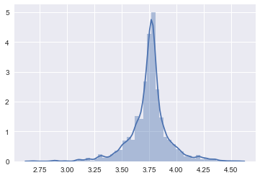
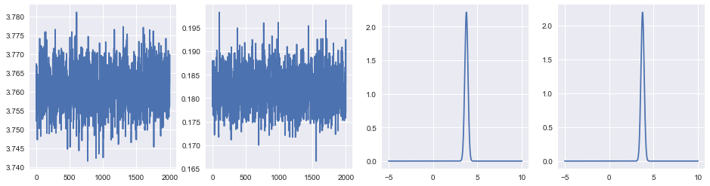

Statistical Sampling - MCMC
exact values: 3.75348532682819 0.18031278127365452 estimated values: 3.7610560688615595 0.18187124252074136
In this section, we plotted average stars per number of review
From fig 1, we can clearly see that the average stars are normally distributed.
With the help of Metropolis algorithm, we MCMC sampled from the posterior distribution by doing an exponential search in the parameter space and estimated a model to fit the target posterior distribution like fig1.
We can see from fig 2 that our sampled model does indeed look exactly like the posterior.

Slide 11


Yelp check-ins

Slide 12
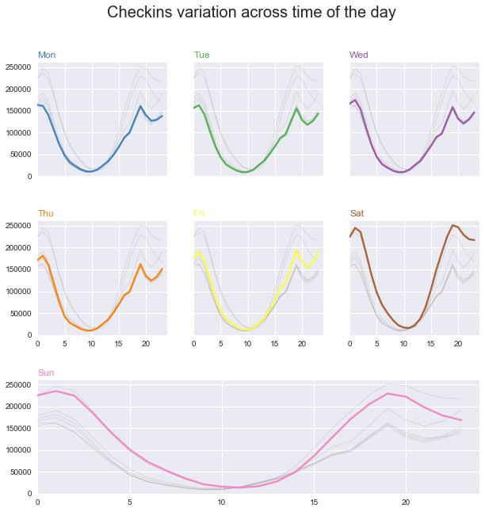
Check-in variation through the time of the day
Check-ins have become an integral part of social media experience.
Essentially, it gives us an idea of how many people go to a restaurant at any time.
From the image alongside, we can see that very few people check-in at an early hour in the day and an early day in the week.
Saturday and Sunday nights see a massive spike in check-ins.

Slide 13
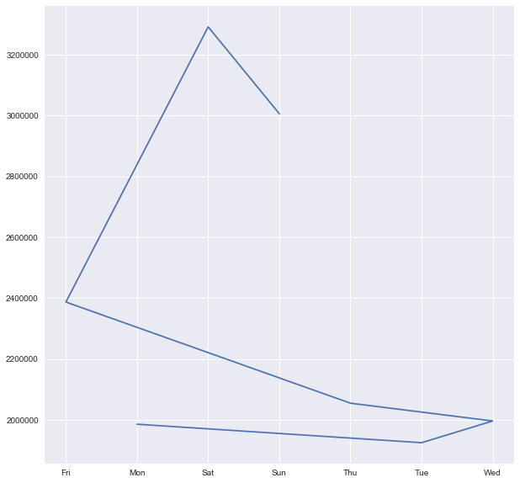
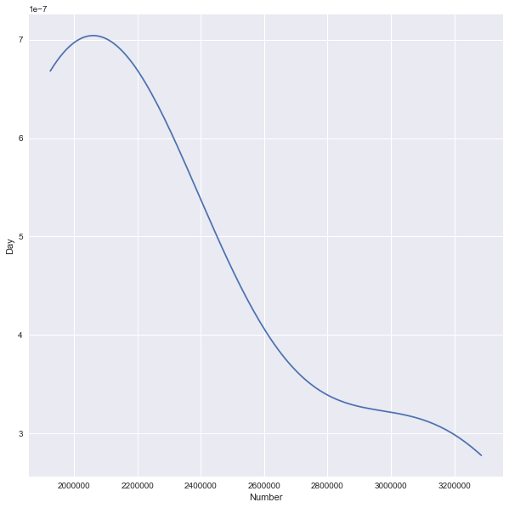
Day wise check-ins and Kernel Density Estimator
In fig 1, we can see the total check-ins progressing through each day of the week.
Essentially, it gives us an idea of how the number of people checking in increases as the week progresses.
In fig 2, we use a non parametric way to estimate the pdf of check-ins. It is known as KDE.
KDE is basically a curve smoothening process which is achieved by assigning more weight to the central point in bins of the pdf.

Slide 14

Reviews and Stars

Slide 15
Estimating star ratings with Linear Regression model and Support Vector Machine model
Combined dataframes yelp_business, yelp_reviews and yelp_checkins to collect more features
1
Trained data on linear regression model from scikitlearn library and predicted the star ratings on the basis of collected features with RMSE and variance score
2
Compared linear regression model with SVM by comparing RMSE and variance score
3
From the results linear regression model outperformed SVM model with RMSE of 0.99 as compared 1.54
4
Variance score for linear regression model comes out to be 0 and for SVM -1.40
5

Slide 16
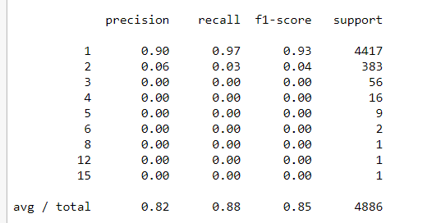
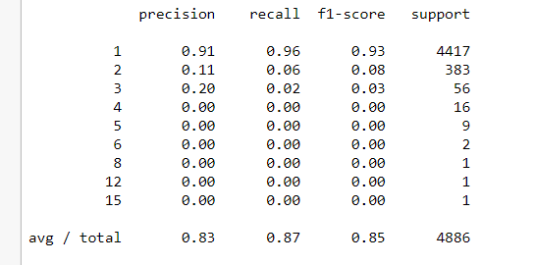
Predicting Likes based on reviews
Used naivebayes classifier and SVM to build a model to predict likes based on the keyword in the reviews
Predicted the accuracy with confusion matrix based on F-1 score
Both models performed equally in terms of accuracy (85%) as data had more likes for (likes = 1)
Key Takeaway-
Both models would have performed better if data had normal distribution for number of likes

Slide 17

Conclusions
We imported the big data files of the Yelp dataset as a part of this project. We then went on to analyze different aspects of the Yelp business, reviews, checkins and users.
By exploring the data, we identified which city has the most businesses in this dataset.
We also identified how the restaurants in this dataset are performing by checking their star rating distribution.
We then explored the most popular Las Vegas and the most popular categories of Yelp businesses therein.
We then went on to analyze the yelp check-ins in depth and built a non parametric method to sample from a pdf by using KDE.
We then built a model to explore the review count and average stars, MCMC estimated a model based on the normal distribution of the data.
We then built linear regression and SVM algorithms to predict the star rating of the restaurants and lastly built a Naive Bayes estimator and SVM to predict the likes based on the reviews of the restaurant.

Slide 18


Thank You

